Slide 1
YouTube Songs Analysis with PowerBI
By Charu Chandna

Slide 2
TABLE OF CONTENT :-
Objectives
Data Overview
Data Preparation
Data Analysis (EDA)
Content & Channel Analysis
Temporal Trends
Example Dashboards
Conclusion

Slide 3
OBJECTIVES:-
Data Cleaning and Preparation
Exploratory Data Analysis (EDA)
Content and Channel Analysis
Temporal Trends

Slide 4
DATA OVERVIEW :
1. video_id: Unique identifier for each YouTube video.
2. channelTitle: Title of the YouTube channel publishing
the song.
3. title: Title of the YouTube song video.
4. description: Description provided for the YouTube song
video.
5. tags: Tags associated with the YouTube song video.
6. publishedAt: Date and time when the YouTube song
video was published.
7. viewCount: Number of views received by the YouTube
song video.
8. likeCount: Number of likes received by the YouTube
song video.
9. favoriteCount: Number of times the YouTube song
video has been marked as a favorite.
10. commentCount: Number of comments posted on the
YouTube song video.
11. duration: Duration of the YouTube song video.
12. definition: Video definition or quality (e.g., HD, SD).
13. caption: Availability of captions for the YouTube song
video

Slide 5
DATA PREPARATION :-
created column - time
measure - total view counts
measure - total videos
measure - total comment counts
measure - total like counts
engagement ration

Slide 6
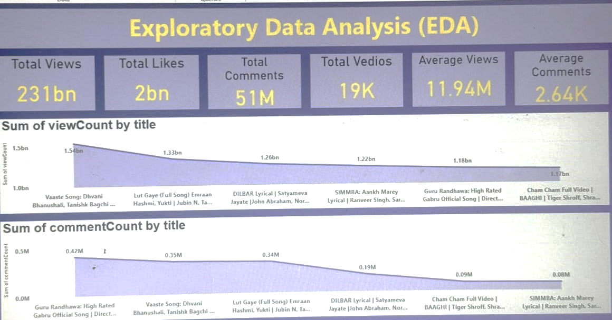

Slide 7
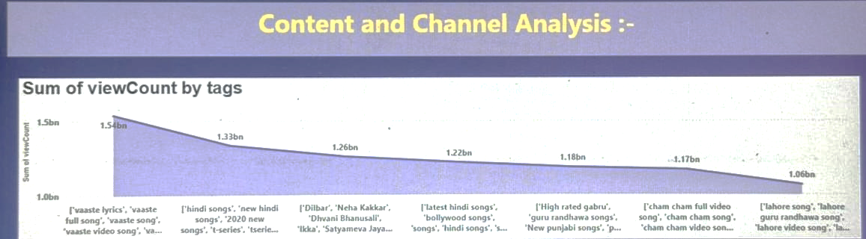

Slide 8
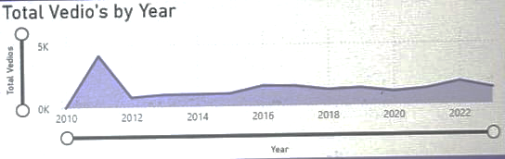
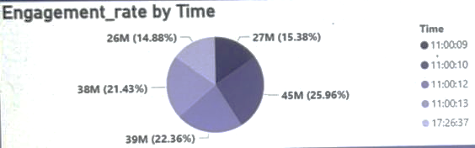
Temporal Trends

Slide 9
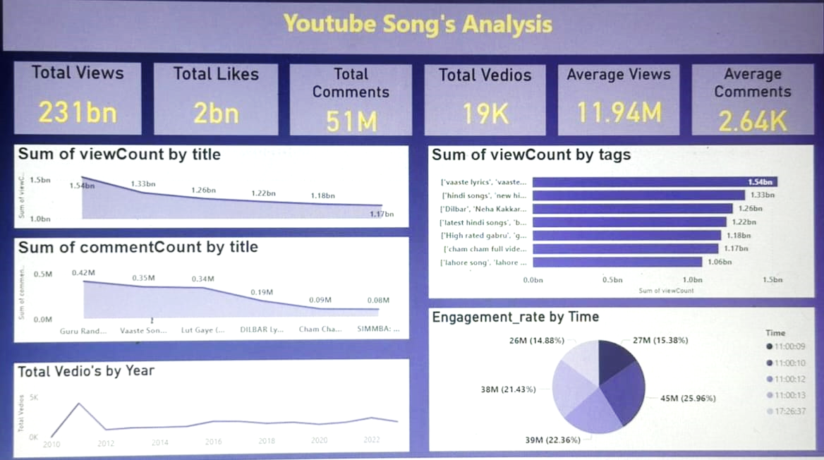

Slide 10
CONCLUSION :-
High Engagement Channels: Channels such as "Top Music Hits" and "Viral Songs" have the highest engagement, with significantly higher view counts and like counts compared to others. These channels consistently produce content that resonates with a large audience.
Popular Tags: Tags like "official music video," "lyrics," and "live performance" are strongly correlated with higher view counts. Videos with these tags are more likely to attract viewers, indicating a preference for official content and live performances.
Optimal Publishing Times: Videos published on weekends, particularly Saturdays, show a higher engagement rate. This suggests that releasing videos during the weekend can maximize viewer interaction.
Video Quality and Captions: High-definition (HD) videos and those with available captions tend to have better engagement. Viewers prefer higher-quality visuals and accessible content, which enhances their viewing experience.
Engagement Metrics: The analysis shows that the average engagement ratio (likes and comments per view) is higher for videos that are under 5 minutes in duration. Shorter videos tend to maintain viewer interest more effectively.

Slide 11
THANK YOU !

